Slide 1
Coffee Sales Analysis
By M. Vaishnavi – 2211CS010336
Using PySpark and Matplotlib

Slide 2
1. Introduction
• The project analyzes coffee shop sales data using PySpark for distributed processing.
• Matplotlib is used for visualizations to reveal key insights on revenue trends, customer behavior, and coffee preferences.
• The analysis identifies top-performing beverages, high-sales hours, and payment methods.

Slide 3
2. Dataset Overview
• Total Records: 3,547 transactions
• Key Columns:
- hour_of_day (hour of purchase)
- cash_type (payment mode)
- money (transaction amount)
- coffee_name (type of coffee)
- Time_of_Day, Weekday, Month_name
• The dataset is clean and ready for analysis.

Slide 4
3. Key Findings
• Total Revenue: $112,245.58
• Average Spend: $31.65 per transaction
• Top Coffees by Revenue:
1. Latte – $26,875
2. Americano with Milk – $24,751
3. Cappuccino – $17,439
• Milk-based beverages dominate overall sales.

Slide 5
4. Time-Based Sales Trends
• Peak sales hours: 10 AM, 11 AM, 4 PM, and 7 PM.
• Morning (10–11 AM) and Afternoon (4 PM) show highest customer traffic.
• Tuesday records the highest revenue among weekdays.
• October and March are top-performing months.

Slide 6
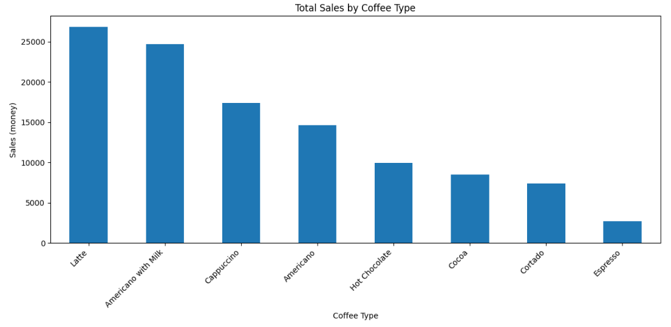
5. Visual Insights
• Bar Chart – Total Sales by Coffee Type

Slide 7
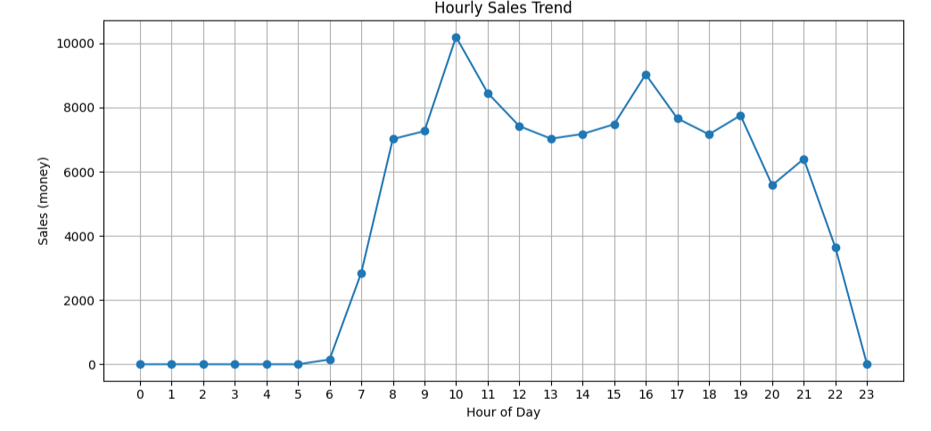
Hourly Sales Trend

Slide 8
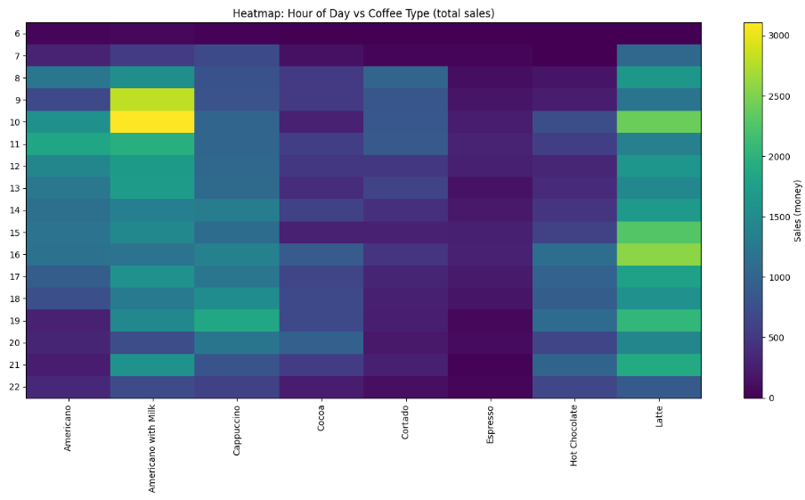
Heatmap (Hour vs Coffee Type)

Slide 9
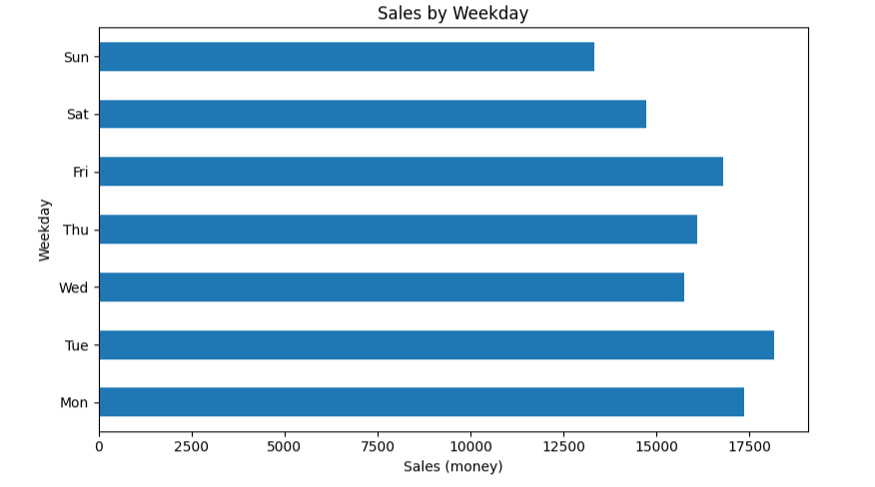
Sales by Weekday

Slide 10
6. Predictive Modeling
• Model Used: Linear Regression (PySpark ML)
• Features: hour_of_day, Weekdaysort
• R² = 0.0588 | RMSE = 4.67
• Time of day slightly influences sales, though the model has low predictive strength.

Slide 11
7. Conclusion & Recommendations
• Latte and Americano with Milk are the best sellers.
• Sales peak in the mid-morning and late afternoon.
• All transactions are digital (card-based).
• Recommendations:
- Offer discounts during peak hours.
- Introduce combo offers for top beverages.
- Plan staffing based on sales heatmap trends.

